Slide 1
Microprocessors and Microcontrollers
Module II

Slide 2
ADDRESSING MODES & Instruction set

Slide 3
Introduction
8086 Microprocessor
Program
A set of instructions written to solve a problem.
Instruction
Directions which a microprocessor follows to execute a task or part of a task.
Computer language
High Level
Low Level
(machine specific)
Machine Language
Assembly Language
 Binary bits
English Alphabets
‘Mnemonics’
Assembler Mnemonics → Machine Language

Slide 4
Machine/Assembly Language
Machine Language:
Set of fundamental instructions the machine can execute
Expressed as a pattern of 1’s and 0’s
Assembly Language:
Alphanumeric equivalent of machine language
Mnemonics(Instructions) more human-oriented than 1’s and 0’s
Assembler:
Computer program that translates (one-to-one mapping) assembly to machine language

Slide 5
Why Assembly Language Programming
Faster and shorter programs.
Compilers do not always generate optimum code.
Instruction set knowledge is important for machine designers.
Compiler writers must be familiar with details of machine language.
Small controllers embedded in many products
Have specialized functions,
Rely so heavily on input/output functionality,
HLLs inappropriate for product development.

Slide 6
ADDRESSING MODES

Slide 7
Addressing Modes
Every instruction of a program has to operate on a data.
The different ways in which a source operand is denoted in an instruction are known as addressing modes.
According to the flow of instruction execution, the instructions may be categorised as
(i) Sequential control flow instructions and
(ii) Control transfer instructions.
Sequential control flow instructions are the instructions, which after execution, transfer control to the next instruction appearing immediately after it (in the sequence) in the program.
e.g.: the arithmetic, logical, data transfer and processor control instructions.
The control transfer instructions, transfer control to some predefined address somehow specified in the instruction after their execution.
e.g.: INT, CALL, RET and JUMP instructions.

Slide 8
Addressing Modes
8086 Microprocessor
The addressing modes for sequential control flow instructions are explained as follows:
Register Addressing
Immediate Addressing
Direct Addressing
Register Indirect Addressing
Indexed Addressing
Register Relative Addressing
Based Indexed Addressing
Relative Based Indexed Addressing

Slide 9
Addressing Modes
8086 Microprocessor
Register Addressing
The instruction will specify the name of the register which holds the data to be operated by the instruction.
Example:
MOV CL, DH
The content of 8-bit register DH is moved to another 8-bit register CL
(CL) ← (DH)

Slide 10
Addressing Modes
8086 Microprocessor
Immediate Addressing
In immediate addressing mode, an 8-bit or 16-bit data is specified as part of the instruction
Example:
MOV DL, 08H
The 8-bit data (08_{H}) given in the instruction is moved to DL
(DL) ← 08_{H}
MOV AX, 0A9FH
The 16-bit data (0A9F_{H}) given in the instruction is moved to AX register
(AX) ← 0A9F_{H}

Slide 11
Addressing Modes
8086 Microprocessor
Here, the effective address of the memory location at which the data operand is stored is given in the instruction.
The effective address is just a 16-bit number written directly in the instruction.
Example:
MOV BX, [1354H]
MOV BL, [0400H]
The square brackets around the 1354_{H} denotes the contents of the memory location. When executed, this instruction will copy the contents of the memory location into BX register.
This addressing mode is called direct because the displacement of the operand from the segment base is specified directly in the instruction.
Direct Addressing

Slide 12
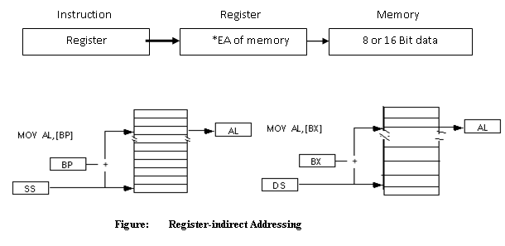
Addressing Modes
8086 Microprocessor
In Register indirect addressing, name of the register which holds the effective address (EA) will be specified in the instruction.
Registers used to hold EA are any of the following registers:
BX, DI and SI.
Content of the DS/ES register is used for base address calculation.
Example: MOV CX, [BX]
Operations:
EA = (BX)
BA = (DS) x 10H
MA = BA + EA
(CX) ← (MA) or,
(CL) ← (MA)
(CH) ← (MA +1)
Register Indirect Addressing
Note : Register/ memory enclosed in brackets refer to content of register/ memory

Slide 13
Addressing Modes
8086 Microprocessor
5. Indexed Addressing
SI or DI(index registers) is used to hold an index value for memory data.DS and ES are default segments for SI and DI respectively.
Offset or Effective Address is stored in one of the index registers.
Example:
MOV CX, [SI]
Operations:
EA = (SI)
BA = (DS) x 10H
MA = BA + EA
(CX) ← (MA) or,
(CL) ← (MA)
(CH) ← (MA + 1)

Slide 14
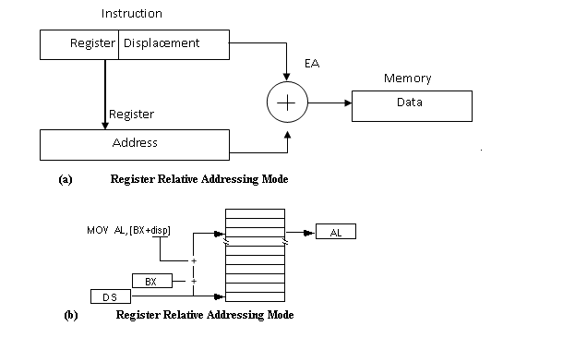
Addressing Modes
8086 Microprocessor
6. Register Relative Addressing
Here data is located at an address equal to sum of a value and contents of a register .
In this addressing, BX, BP, SI and DI is used to hold the base value for effective address and a signed 8-bit or unsigned 16-bit displacement will be specified in the instruction.DS or ES segment contains the base address.
In case of 8-bit displacement, it is sign extended to 16-bit before adding to the base value.
Example:
MOV AX, [BX + 08H] or
Mov AX, 08H[BX]
Operations:
0008_{H} ← 08_{H} (Sign extended)
EA = (BX) + 0008_{H}
BA = (DS) x 10H
MA = BA + EA
(AX) ← (MA) or,
(AL) ← (MA)
(AH) ← (MA + 1)

Slide 15
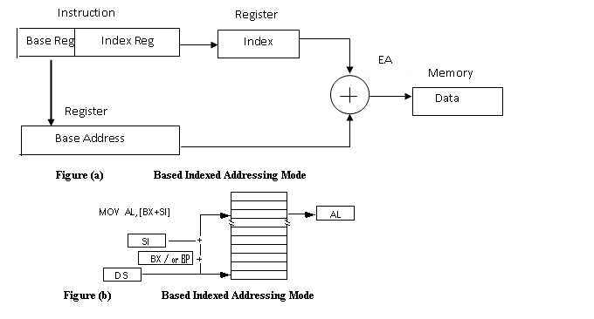
Addressing Modes
8086 Microprocessor
Based Indexed Addressing
In Based Indexed Addressing, the effective address is computed from the sum of a base register (BX or BP), and an index register (SI or DI). Default segment register may be ES or DS.
Example:
MOV DX, [BX + SI ] or
Mov DX, [BX] [SI]
Operations:
EA = (BX) + (SI)
BA = (DS) x 10H
MA = BA + EA
(DX) ← (MA) or,
(DL) ← (MA)
(DH) ← (MA + 1)

Slide 16
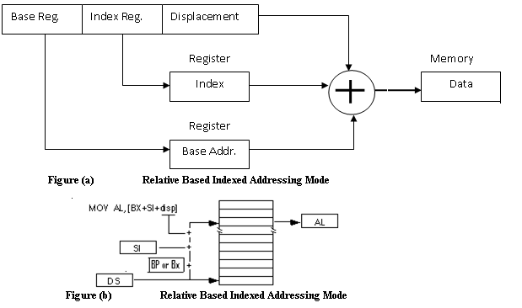
Addressing Modes
8086 Microprocessor
8. Relative Based Indexed Addressing
In this addressing mode, the effective address is formed by adding an 8-bit or 16-bit displacement with the sum of contents of any one of the bases registers (BX or BP) and any one of the index registers, in a default segment.
Example: MOV AX, 50H [BX] [SI] Here, 50H is an immediate displacement, BX is a base register and SI is an index register.
Operations:
EA = (BX) + (SI) + 50H
BA = (DS) x 10H
MA = BA + EA
(AX) ← (MA) or,
(AL) ← (MA)
(AH) ← (MA + 1)

Slide 17
Addressing Modes
For the control transfer instructions, the addressing modes depend upon
whether the destination location is within the same segment or a different one.
It also depends upon the method of passing the destination address to the processor.
Basically, there are two addressing modes for the control transfer instructions, viz. inter-segment and intra-segment addressing modes.
If the location to which the control is to be transferred lies in a different segment other than the current one, the mode is called inter-segment mode.
If the location to which control is to be transferred is in the same segment, it is called intra segment mode.

Slide 18
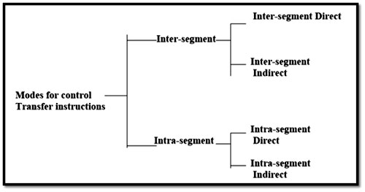
Addressing Modes

Slide 19
Addressing Modes
1. Intra Segment Direct Mode If address to which the control is to be transferred appears directly in the instruction as a displacement value, it is what called as intra segment direct mode.
example, JMP SHORT LABEL; is a control transfer instruction following intra segment direct mode. Here, SHORT LABEL represents a signed displacement.

Slide 20
Addressing Modes
2. Intra Segment Indirect Mode If the location to which control is to transferred is in the same segment, it is called intra segment mode. If address to which the control is to be transferred appears indirectly in the instruction, it is what called as intra segment indirect mode.
example, JMP [AX]; is a control transfer instruction following intra segment indirect mode.

Slide 21
Addressing Modes
3. Inter Segment Direct Mode If address of segment to which the control is to be transferred is in a different segment and location in the segment appears directly in the instruction, it is what called as inter segment direct mode.
example, JMP 2000H : 3000H; is a control transfer instruction following inter segment direct mode. Here, Jump is to effective address 3000H in segment at 2000H.

Slide 22
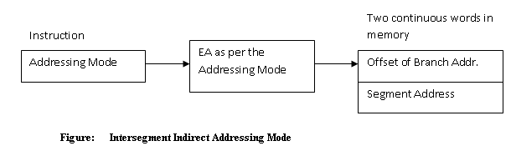
Addressing Modes
4. Inter Segment Indirect Mode If the address to which the control is to be transferred lies in a different segment and it appears indirectly in the instruction, it is what called as inter segment indirect mode.
example, JMP [5000H]; is a control transfer instruction following inter segment indirect mode.
- Jump to an address in the other (code) segment, specified at effective address 5000H.
5000H points to the memory block containing new values for IP (LSB),IP(MSB),CS(LSB),CS(MSB) sequentially].

Slide 23
INSTRUCTION SET

Slide 24
Instruction set types of 8086 microprocessor
(1). Data Copy/Transfer instructions.
(2). Arithmetic instructions.
(3). Logical instructions
(4). Branch instructions.
(5). Loop instructions.
(6). Machine Control instructions.
(7). Flag Manipulation instructions.
(8). Shift & Rotate instructions.
(9). String instructions.

Slide 25
(1). Data copy/transfer instructions.
(1). MOV Destination, Source;
There will be transfer of data from source to destination.
Source can be register, memory location or immediate data.
Destination can be register or memory operand.
Both Source and Destination cannot be memory location or segment registers at the same time.
E.g.
(1). MOV CX, 037A H;
(2). MOV AL, BL;
(3). MOV BX, [0301 H];

Slide 26
Stack Pointer
It is a 16-bit register, contains the address of the data item currently on top of the stack.
Stack operation includes pushing (providing) data on to the stack and popping (taking)data from the stack.
Pushing operation decrements stack pointer and Popping operation increments stack pointer. i.e. there is a last in first out (LIFO) operation.

Slide 27
(1). Data copy/transfer instructions.
(2). Push Source;
Source can be register, segment register or memory.
This instruction pushes the contents of specified source on to the stack.
In this stack pointer is decremented by 2.
The higher byte data is pushed first (SP-1).
Then lower byte data is pushed (SP-2).
Instructions like PUSH AL ; is illegal, must push a word.
E.g.:
(1). PUSH AX;
(2). PUSH DS;
(3). PUSH [5000H];

Slide 28
(1). Data copy/transfer instructions.
(3). POP Destination;
Destination can be register, segment register or memory.
This instruction pops (takes) the contents of specified destination.
In this stack pointer is incremented by 2.
The lower byte data is popped first (SP+1).
Then higher byte data is popped (SP+2).
E.g.
(1). POP AX;
(2). POP DS;
(3). POP [5000H];

Slide 29
(1). Data copy/transfer instructions.
(4). XCHG Destination, source;
This instruction exchanges contents of Source with destination.
It cannot exchange two memory locations directly.
The contents of AL are exchanged with BL.
The contents of AH are exchanged with BH.
E.g.
(1). XCHG BX, AX;
(2). XCHG [5000H],AX;
(3).XCHG BL,CH;

Slide 30
BEFORE EXECUTION
AFTER EXECUTION
AH | 20 | AL | 40
BH | 70 | BL | 80
AH | 70 | AL | 80
BH | 20 | BL | 40
XCHG AX,BX;

Slide 31
(1). Data copy/transfer instructions.
(5). IN AL/AX, 8-bit/16-bit port address
It reads from the specified port address.
It copies data to accumulator from a port with 8-bit or 16-bit address.
DX is the only register is allowed to carry port address.
E.g.
(1). IN AL, 80H;
(2). IN AX,DX; //DX contains address of 16-bit port.

Slide 32
BEFORE EXECUTION
PORT 80H
 | 10
AL
IN AL,80H;
AFTER EXECUTION
PORT 80H
 | 10
AL | 10

Slide 33
(1). Data copy/transfer instructions.
(6). OUT 8-bit/16-bit port address, AL/AX;
It writes to the specified port address.
It copies contents of accumulator to the port with 8-bit or 16-bit address.
DX is the only register is allowed to carry port address.
E.g.
(1). OUT 80H,AL;
(2). OUT DX,AX; //DX contains address of 16-bit port.

Slide 34
BEFORE EXECUTION
PORT 50H
 | 10
AL | 40
OUT 50H,AL;
AFTER EXECUTION
PORT 50H
 | 40
AL | 40

Slide 35
(1). Data copy/transfer instructions.
(7). XLAT;
Also known as translate instruction.
The instruction requires BX to be initialized, to have the offset of the translation table:
MOV BX , OFFSET Translation Table Name
The contents of the byte that is AL bytes from the start of the translation table pointed to by DS:BX is copied into AL, i.e., the effect of XLAT is equivalent to the invalid statement:
MOV AL , [BX + AL]
After execution this instruction contents of AL register always gets replaced.
E.g. XLAT;

Slide 36
Example: Suppose a byte variable VAR1 has a value in the range 0 to 15. Display this value as a hexadecimal digit.
DATA SEGMENT
HEXDIGIT DB ‘0123456789ABCDEF’
VAR1 DB ?
……..
. . .
MOV AX , DATA
MOV DS , AX
. . .
MOV AL , VAR1
MOV BX , OFFSET HEXDIGIT
XLAT
MOV DL , AL
MOV AH , 02H
INT 21H
If the value in VAR1 is, say, 12 then ‘C’ is copied to AL by the XLAT instruction. If AL contained a value not in the range 0 to 15, XLAT would translate it to some garbage value.

Slide 37
(1). Data copy/transfer instructions.
(8). LEA 16-bit register (dest.), address (source);
LEA Also known as Load Effective Address (LEA).
This instruction indicates the offset of the variable or memory location named as the source and put this offset in the indicated 16 – bit register.
E.g.
(1). LEA SI, STRING1; Load SI with offset of STRING1 in DS
(2). LEA CX, [BX][DI];

Slide 38
(1). Data copy/transfer instructions.
(9). LDS register, memory address of first word.
(10). LES register, memory address of first word.
LDS Also known as Load Data Segment (LDS)-Load register and DS with words from memory.
LES Also known as Load Extra Segment (LES)- Load register and ES with words from memory.
Copies a word from the first two memory locations into the register specified in the instruction and words from next two memory locations into the DS/ ES register.
Useful for pointing (SI and DS)/ (DI and ES) at the start of a string before using one of the string instructions.
E.g.
(1). LDS SI,[5000H];
(2). LES DI, [5000H];

Slide 39
(1). LDS SI,[5000H]
(2). LES DI,[5000H];
15
0
7
0
SI/DI
20 | 10
10
20
30
40
5000H
5001H
DS/ES
40 | 30
5002H
5003H

Slide 40
(1). Data copy/transfer instructions.
(11). LAHF:-
LAHF instruction loads lower byte of the FLAGS register into AH register.
LAHF instruction copies the value of SF, ZF, AF, PF, CF, into bits of 7, 6, 4, 2, 0 respectively of AH register. This LAHF instruction was provided to make conversion of assembly language programs written for 8080 and 8085 to 8086 easier.
E.g. LAHF;
(12). SAHF:- Copy AH register to low byte of flag register.
This instruction sets or resets all conditional flags of flag register with respect to the corresponding bit positions.
If bit position in AH is 1 then related flag is set otherwise flag will be reset.
E.g. SAHF;

Slide 41
(1). Data copy/transfer instructions.
(13). PUSH F:- This instruction decrements the stack pointer by 2.
It copies contents of flag register to the memory location pointed by stack pointer.
E.g. PUSH F;
(14). POP F:- This instruction increments the stack pointer by 2.
It copies contents of memory location pointed by stack pointer to the flag register.
E.g. POP F;

Slide 42
(2). Arithmetic Instructions
The arithmetic instructions include
addition , subtraction
multiplication, division
comparison
negation
increment
decrement.

Slide 43
(2). Arithmetic Instructions
(1). ADD destination, source;
This instruction adds the contents of source operand with the contents of destination operand.
The source may be immediate data, memory location or register.
The destination may be memory location or register.
The result is stored in destination operand.
AX is the default destination register.
It effects AF, CF, OF, PF, SF, ZF flags.
E.g. (1). ADD AX,2020H;
(2). ADD AX,BX;

Slide 44
BEFORE EXECUTION
AFTER EXECUTION
AH | 10 | AL | 10
ADD AX,2020H
AH | 30 | AL | 30
1010
+2020
3030
BEFORE EXECUTION
AFTER EXECUTION
AH | 10 | AL | 10
BH | 20 | BL | 20
AH | 30 | AL | 30
BH | 20 | BL | 20
ADD AX,BX
2050

Slide 45
(2). Arithmetic Instructions
(2). ADC destination, source
This instruction adds the contents of source operand with the contents of destination operand with carry flag bit.
The source may be immediate data, memory location or register.
The destination may be memory location or register.
The result is stored in destination operand.
AX is the default destination register.
It effects AF, CF, OF, PF, SF, ZF flags.
E.g. (1). ADC AX,2020H;
(2). ADC AX,BX;
(3). ADC AL, [DI];

Slide 46
BEFORE EXECUTION
AFTER EXECUTION
ADC AX,2020H
CY | 1
AH | 10 | AL | 10
AH | 30 | AL | 31
1010
+2020
3030+1=3031
BEFORE EXECUTION
AFTER EXECUTION
CY | 1
AH | 10 | AL | 10
BH | 20 | BL | 20
AH | 30 | AL | 31
BH | 20 | BL | 20
ADC AX,BX
2050

Slide 47
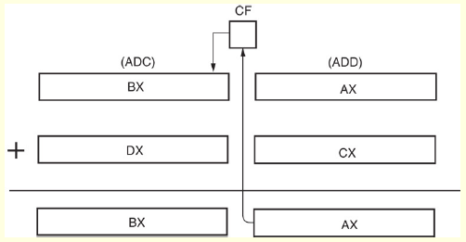
ADD AX, CX
ADC BX, DX
Addition-with-carry showing how the carry flag (C)
links the two 16-bit additions into one 32-bit addition.

Slide 48
(2). Arithmetic Instructions
(3). INC source
This instruction increases the contents of source operand by 1.
The source may be memory location or register.
The source can not be immediate data.
The result is stored in the same place.
It effects AF, OF, PF, SF, ZF flags.
CF is not affected.
E.g. (1). INC AX;
(2). INC [5000H];

Slide 49
BEFORE EXECUTION
AFTER EXECUTION
AH | 10 | AL | 10
INC AX
AH | 10 | AL | 11
BEFORE EXECUTION
AFTER EXECUTION
1010
INC [5000H]
5000H
1011
5000H

Slide 50
(2). Arithmetic Instructions
(4). DEC source;
This instruction decreases the contents of source operand by 1.
The source may be memory location or register.
The source can not be immediate data.
The result is stored in the same place.
It effects AF, OF,PF, SF, ZF flags.
CF is not affected.
E.g. (1). DEC AX;
(2). DEC [5000H];

Slide 51
BEFORE EXECUTION
AFTER EXECUTION
AH | 10 | AL | 10
DEC AX
AH | 10 | AL | 09
BEFORE EXECUTION
AFTER EXECUTION
1010
DEC [5000H]
5000H
1009
5000H

Slide 52
(2). Arithmetic Instructions
(5). SUB destination, source;
This instruction subtracts the contents of source operand from contents of destination.
The source may be immediate data, memory location or register.
The destination may be memory location or register.
The result is stored in the destination place.
It effects AF, CF, OF, PF, SF, ZF flags.
For subtraction, CF acts as borrow flag.
E.g. (1). SUB AX,1000H;
(2). SUB AX,BX;

Slide 53
BEFORE EXECUTION
AFTER EXECUTION
AH | 20 | AL | 00
SUB AX,1000H
AH | 10 | AL | 00
2000
-1000
=1000
BEFORE EXECUTION
AFTER EXECUTION
AH | 20 | AL | 00
BH | 10 | BL | 00
AH | 10 | AL | 00
BH | 10 | BL | 00
SUB AX,BX

Slide 54
(2). Arithmetic Instructions
(6). SBB destination, source;
Also known as Subtract with Borrow.
This instruction subtracts the contents of source operand & borrow from contents of destination operand.
The source may be immediate data, memory location or register.
The destination may be memory location or register.
The result is stored in the destination place.
It effects AF, CF, OF, PF, SF, ZF flags.
E.g. (1). SBB AX,1000H;
(2). SBB AX,BX;

Slide 55
BEFORE EXECUTION
AFTER EXECUTION
SBB AX,1000H
B | 1
AH | 20 | AL | 20
AH | 10 | AL | 19
2020
- 1000
1020-1=1019
BEFORE EXECUTION
AFTER EXECUTION
B | 1
AH | 20 | AL | 20
BH | 10 | BL | 10
AH | 10 | AL | 19
BH | 10 | BL | 10
SBB AX,BX
2050

Slide 56
(2). Arithmetic Instructions
(7). CMP destination, source
Also known as Compare.
This instruction compares the contents of source operand with the contents of destination operands.
The source may be immediate data, memory location or register.
The destination may be memory location or register.
The CMP instruction accomplishes its task by subtracting the value of the source operand from the value of the destination operand, but it does not store the result into the destination operand.
Then resulting carry & zero flag will be set or reset.
E.g. (1). CMP AX,1000H;
(2). CMP AX,BX;

Slide 57
D=S: CY=0,Z=1
D>S: CY=0,Z=0
D<S: CY=1,Z=0
BEFORE EXECUTION
AFTER EXECUTION
AH | 10 | AL | 00
BH | 10 | BL | 00
CMP AX,BX
CY | 0 | Z | 1
BEFORE EXECUTION
AFTER EXECUTION
AH | 10 | AL | 00
BH | 00 | BL | 10
CMP AX,BX
CY | 0 | Z | 0
BEFORE EXECUTION
AFTER EXECUTION
AH | 10 | AL | 00
BH | 20 | BL | 00
CMP AX,BXH
CY | 1 | Z | 0

Slide 58
(2). Arithmetic Instructions ASCII Arithmetic
ASCII arithmetic instructions function with coded numbers, value 30H to 39H for 0–9.
Four instructions in ASCII arithmetic operations:
AAA (ASCII adjust for addition)
AAD (BCD to Binary convert before division)
AAM(BCD adjust after multiplication)
AAS (ASCII adjust for subtraction)

Slide 59
(2). Arithmetic Instructions ASCII Arithmetic
(8). AAA (ASCII adjust for/(after) addition):
The data entered from the terminal is in ASCII format.
In ASCII, 0 – 9 are represented by 30H –39H.This instruction allows us to add the ASCII codes.
AAA is then used to make sure the result is correct unpacked BCD.
This instruction does not have any operand.
Works only on AL register.
Updates AF and CF flags.

Slide 60
(2). Arithmetic Instructions ASCII Arithmetic
Example:
MOV AL, ‘5’ ; AL = 35
ADD AL, ‘2’ ; add to AL 32 the ASCII of 2,
;(AL) = 35 + 32=67
AAA ; changes 67H to 07H,
AL = 7
OR AL, 30 ; OR AL with 30 to get ASCII

Slide 61
(2). Arithmetic Instructions ASCII Arithmetic
Example
SUB AH, AH ; AH = 00H
MOV AL, ’7’ ; AL = 37H
MOV BL, ‘5’ ; BL = 35H
ADD AL, BL ; AL= 37H+35H=6CH
AAA ; changes 6CH to 02 in AL and AH=CF=1
OR AX, 3030H ; AX = 3132 which is the ASCII for 12H

Slide 62
(2). Arithmetic Instructions ASCII Arithmetic
(9). AAS- ASCII adjust for/(after) subtraction
8086 allows us to subtract the ASCII codes for two decimal digits without masking the “3” in the upper nibble of each.
AAS instruction is then used to make sure the result is correct unpacked BCD.
Example
(a)
;AL =0011 1001 =ASCII 9
;BL=0011 0101 =ASCII 5
SUB AL, BL ;(9 - 5) Result :
;AL = 00000100 = BCD 04,CF = 0
AAS ;Result :
;AL=00000100 =BCD 04
;CF = 0 NO Borrow required

Slide 63
(b)
;AL = 0011 0101 =ASCII 5
;BL = 0011 1001 = ASCII 9
SUB AL, BL ;( 5 - 9 ) Result :
;AL = 1111 1100 = - 4
; in 2’s complement CF = 1
AAS ;Results :
;AL = 0000 0100 =BCD 04
;CF = 1 borrow needed .

Slide 64
(2). Arithmetic Instructions ASCII Arithmetic
(10). AAM –BCD Adjust after Multiply
8086 does not allow multiplication of ASCII codes for decimal digits directly.
Before multiplication mask the upper 4 bits of each number(unpacked BCD).
Adjusts the result of the multiplication of two unpacked BCD values to create a pair of unpacked BCD values in AX.
Works only on an operand in AL.
PF, SF and ZF flags are updated.
The AAM instruction is only useful when it follows an MUL instruction.
Example:
MOV DL,5 ; DL = 5H
MOV AL, 6 ; AL = 6H
MUL DL ; AX=AL x DL= 05 x 06
=001EH=30H
AAM ; AX=0300(unpacked BCD)

Slide 65
(2). Arithmetic Instructions ASCII Arithmetic
Example:
MOV AL,’7’ ; AH = 00H,AL=37 H
AND AL, 0F ; AL=07 unpacked BCD
MOV DL,’6’ ; DL=36H
AND DL,0FH ; DL=06 unpacked BCD
MUL DL ; AX=AL x DL= 07 x 06 =002AH=42 decimal
AAM ; AX=0402 (7x6=42 unpacked BCD)
OR AX, 3030H ; AX=3432H result in ASCII

Slide 66
(2). Arithmetic Instructions ASCII Arithmetic
(11). AAD - BCD –to-Binary Convert before Division
Also known as ASCII Adjust before Division.
Appears before a division.
The AAD instruction requires the AX register contain a two-digit unpacked BCD number (not ASCII) before executing.
Before dividing the unpacked BCD by another unpacked BCD, AAD is used to convert it to HEX. By doing that the quotient and remainder are both in unpacked BCD.
PF,SF and ZF flags updated.
Example
MOV AX, 3539H ; AX = 3539 ASCII for 59
AND AX, 0F0FH ; AH=05, Al=09 unpacked BCD data
AAD ; AX=003BH equivalent of 59 decimal
MOV BH, 08H ; divide by 08H(unpacked BCD)
DIV BH ; 3BH/08H gives AL=07,AH=03
OR AX,3030H ; AL=37H (quotient),AH= (remainder)

Slide 67
(2). Arithmetic Instructions BCD Arithmetic
Two arithmetic techniques operate with BCD data: addition and subtraction.
(12). DAA- Decimal Adjust Accumulator
DAA (decimal adjust after addition) instruction follows BCD addition.
It is used to make sure that the result of adding two BCD numbers is adjusted to be a correct BCD number.
It only works on AL register.
If the least significant four bits in AL are >9 or if AF=1, it adds 6 to AL and sets AF.
If the most significant four bits in AL are >9 or if CF=1,it adds 60 to AL and sets the CF.

Slide 68
(2). Arithmetic Instructions BCD Arithmetic
DAA follows the ADD or ADC instruction to adjust the result into a BCD result.
MOV DX, 1234H ; load 1234 into DX
MOV BX, 3099H ; load 3099 into BX
MOV AL, BL
ADD AL, DL ; add AL wiith DL
DAA ; adjust
MOV CL, AL ; answer to CL
MOV AL, BH
ADC AL, DH ; add AL, DH, and carry
DAA ; adjust
MOV CH, AL ; answer to CH
After adding the AL and DL registers, the result is adjusted with a DAA instruction before being stored in CH.

Slide 69
(2). Arithmetic Instructions BCD Arithmetic
The DAA instruction works as follows :
(a) MOV AL, 59H ; load 59 into AL
ADD AL, 35H ; AL 59H+35H =8EH =1000 1110
DAA ; add 0110 because 1110>9
; AL= 1001 0100= 94 BCD
(b) ;AL=88 = 1000 1000
;BL=49 = 0100 1001
ADD AL,BL ;AL= 1101 0001, AF=1
DAA ; add 0110 because AF=1
; AL= 1101 0111 =D7 H
; 1101>9 so add 0110 0000
; AL =0011 0111 = 37 BCD ,CF=1 i.e.137 decimal

Slide 70
(2). Arithmetic Instructions BCD Arithmetic
(13). DAS (decimal adjust after subtraction)
follows BCD subtraction.
It is used to make sure that the result of subtracting two BCD numbers is adjusted to be a correct BCD number.
It only works on AL register.
If the least significant four bits in AL are >9 or if AF=1, it subtracts 6 from AL and sets AF.
If the most significant four bits in AL are >9 or if CF=1, it subtracts 60 from AL and sets the CF.
OF flag undefined . All other flags affected.
Both DAA and DAS correct the result of addition or subtraction so it is a BCD number.

Slide 71
DAS
DAS follows the SUB or SBB instruction to adjust the result into a BCD result. After subtracting the AL and DL registers, the result is adjusted with a DAS instruction before being stored in CH.
MOV DX, 1234H ; load 1234 into DX
MOV BX, 3099H ; load 3099 into BX
MOV AL, BL
SUB AL, DL ; sub AL wiith DL
DAS ; adjust
MOV CL, AL ; answer to CL
MOV AL, BH
SBB AL, DH ; sub AL, DH, and carry
DAS ; adjust
MOV CH, AL ; answer to CH

Slide 72
The DAS instruction works as follows :
(a) ;AL =1000 0110=86
; BH=0101 0111=57
SUB AL, BH ; AL =0010 1111=2FH,CF=0
DAS ;subtract 0000 0110(-06H)
;because 1111 in low nibble>9 ;AL=0010 1001=29 BCD
;AL=0100 1001=49
;BH=0111 0010=72
SUB AL,BH ;AL=1101 0111=D7H, CF=1
DAS ;Subtract 0110 0000 (-60H)
;because 1101 in upper nibble > 9
;AL=0111 0111 =77 BCD, CF=1, means borrow was needed.

Slide 73
(2). Arithmetic Instructions
(14). MUL Src; Unsigned Multiplication.
Operand may be general purpose register or memory location.
If operand is of 8-bit then multiply it with contents of AL.
If operand is of 16-bit then multiply it with contents of AX.
It multiplies two bytes to produce a word or two words to produce a double word.
Affected flags are C and O.
Set: if higher byte of result not zero
Reset: the result fit exactly the lower half.
Product after a multiplication always a double-width product.

Slide 74
(2). Arithmetic Instructions
Two 8-bit numbers multiplied generate a 16-bit product.
Two 16-bit numbers multiplied generate a 32-bit product.
Two 32-bit numbers multiplied generate a 64-bit product.
AX = AL * Src
DX : AX = AX * Src
This instruction assumes one of the operand in AL or AX.
With 8-bit multiplication, the multiplicand is always in the AL register and for 16 – bit multiplication the multiplicand is always in the AX register.
Immediate multiplication is not allowed.

Slide 75

Example- 8 bit Multiplication
MOV AL, 05H ; a byte is moved to AL
MOV BL, 10H ; immediate data must be in BL
MUL BL ; multiply
MOV DX, AX ; position product
AX = AL*BL after multiplication.
The Carry flag is clear (CF = 0) because AH (the upper half of the product) equals zero.

Slide 76
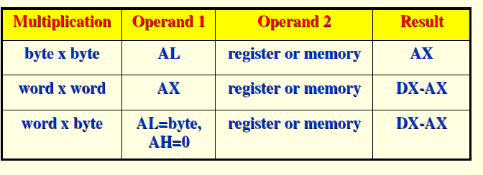
Example- 16-Bit Multiplication
MOV AX,2000H ; a word is moved to AX
MOV BX, 0100H ; immediate data must be in BX
MUL BX ; DX:AX = 0020 0000H, CF = 1
The Carry flag is set because the upper part of the product (located in DX) is not equal to zero.
Summary of Multiplication

Slide 77
(2). Arithmetic Instructions
(15). IMUL src;
The IMUL (signed multiply) instruction performs signed integer multiplication.
Unlike the MUL instruction, IMUL preserves the sign of the product.
It does this by sign extending the highest bit of the lower half of the product into the upper bits of the product.
Accumulator is the multiplicand and ‘src’ is the multiplier.
Only CF and OF flags affected.
IMUL reg/mem8 ; AX = AL*reg/mem8
IMUL reg/mem16 ; DX:AX = AX * reg/mem16

Slide 78
Example:
; 69 * 14
; AL = 01000101 = 69 decimal
; BL = 00001110 = 14 decimal
IMUL BL ;AX = 03C6H = + 966 decimal
;MSB = 0 because positive result
; - 28 * 59
; AL = 11100100 = - 28 decimal
;BL = 00001110 = 14 decimal
IMUL BL ;AX = F98Ch = - 1652 decimal
; MSB = 1 because negative result

Slide 79
(2). Arithmetic Instructions
(16). DIV operand
This instruction is used to divide an Unsigned word by a byte or to divide an unsigned double word by a word.
When dividing a word by a byte , the word must be in the AX register.
After the division AL will contains an 8- bit result (quotient) and AH will contain an 8- bit remainder.
If you want to divide a byte by a byte, you must first put the dividend byte in AL and fill AH with all 0’s .
If you want to divide a word by a word, put the dividend word in AX and fill DX with all 0’s.

Slide 80
(2). Arithmetic Instructions
If an attempt is made to divide by 0 or the quotient is too large to fit in AL ( greater than FFH ), the 8086 will automatically do a type 0 interrupt .
When a double word is divided by a word, the most significant word of the double word must be in DX and the least significant word of the double word must be in AX.
After the division AX will contain the 16 –bit result quotient ) and DX will contain a 16 bit remainder.
Again , if an attempt is made to divide by zero or quotient is too large to fit in AX ( greater than FFFFH ) the 8086 will do a type of 0 interrupt .

Slide 81
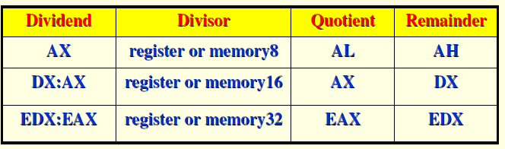
(2). Arithmetic Instructions
Example:
; AX = 37D7H = 14, 295 decimal
; BH = 97H = 151 decimal
DIV BH ;AX / BH
; AL = Quotient = 5EH = 94 decimal
; AH = Remainder = 65H = 101 decimal

Slide 82
(2). Arithmetic Instructions
(17). IDIV operand- Signed Division.
This instruction is used to divide a signed word by a signed byte or to divide a signed double word by a signed word.
Operand may be general purpose register or memory location.
AL=AX/Operand (8-bit/16-bit) & AH=Remainder.
All flags are undefined after DIV and IDIV.
Example:
IDIV BL ;Signed word in AX is divided by signed byte in BL
IDIV BP ;divide a Signed double word in DX and
;AX by signed word in BP

Slide 83
(2). Arithmetic Instructions
A signed byte divided by a signed byte
;AL=11001010= -26H=-38 decimal
;CH=00000011= +3H = + 3 decimal
CBW ; Extend sign of AL through AH,
;AX=11111111 11001010
IDIV CH ; Divide AX by CH
; AL=11110100 = -0CH = -12 decimal
;AH = 11111110 = -2H = -2 decimal
A signed word divided by a signed byte
;AX = 00000011 10101011 = 03ABH=939 decimal
;BL = 11010011 = D3H = - 2DH= - 45 decimal
IDIV BL ;Quotient in AL=11101100
;= - 14H = -20 decimal
;Remainder in AH = 00100111=27H
; = + 39 decimal

Slide 84
(2). Arithmetic Instructions
(18). NEG: Negation - NEG Src
It creates two’s complement of a given number.
That means, it changes the sign of a number.
The arithmetic sign of a signed number changes from positive to negative or negative to positive.
All conditional flags updated.
NEG can use any addressing mode.
NEG function is considered an arithmetic operation.
This instruction forms 2’s complement by subtracting the original word or byte in the indicated destination from zero.

Slide 85
;AX = 2CBh
NEG AX ;after executing NEG
;result AX =FD35h.
Example:
NEG AL ;Replace number in AL with its 2’s
;complement
NEG BX ;Replace word in BX with its 2’s
;complement
NEG BYTE PTR[BX] ; Replace byte at offset BX in
; DS with its 2’s complement

Slide 86
(2). Arithmetic Instructions Sign Extension Instructions (CBW, CWD)
(19). CBW - Convert signed byte to signed word.
The CBW instruction (convert byte to word) extends the sign bit of AL into AH, preserving the number’s sign.
This operation must be done before a signed byte in AL can be divided by another signed byte with the IDIV instruction.
Flags not affected.
In the next example, 9BH (in AL) and FF9BH (in AX) both equal −101 decimal:
Example
MOV AL, 9BH ; AL = 9BH
CBW ; AX = FF9BH

Slide 87
(2). Arithmetic Instructions Sign Extension Instructions (CBW, CWD)
(20). CWD – Convert signed word to Signed Double word
The CWD instruction (convert word to double word) extends the sign bit of AX into DX, preserving the number’s sign.
This operation must be done before a signed word in AX can be divided by another signed word with the IDIV instruction.
Flags not affected.
Example
MOV AX, FF9BH ; AX = FF9BH
CWD ; content of DX:AX = FFFFFF9BH

Slide 88
(3). Logical Instructions
(1). AND destination, source
This Performs a bitwise Logical AND of two operands. The result of the operation is stored in the op1 and used to set the flags.
To perform a bitwise AND of the two operands, each bit of the result is set to 1 if and only if the corresponding bit in both of the operands is 1, otherwise the bit in the result is cleared to 0 .
The AND instruction affects the zero flag (ZF), the sign flag (SF), the parity flag (PF) and resets both the carry flag (CF = 0) and overflow flag (OF = 0).
AND BH, CL ;AND byte in CL with byte in BH
;result in BH
AND BX,00FFh ;AND word in BX with immediate
;00FFH. Mask upper byte, leave
;lower unchanged

Slide 89
(3). Logical Instructions
(2). OR destination,source
OR instruction perform the bit wise logical OR of two operands. Each bit of the result is cleared to 0 if and only if both corresponding bits in each operand are 0, other wise the bit in the result is set to 1.
Examples :
OR AH, CL ;CL OR ed with AH, result in AH.
;CX = 00111110 10100101
OR CX,FF00h ;OR CX with immediate FF00h
;result in CX = 11111111 10100101
;Upper byte are all 1’s lower bytes
;are unchanged.

Slide 90
(3). Logical Instructions
(3). NOT operand;
NOT perform the bitwise complement of operand and stores the result back into operand.
Example :
NOT BX ;Complement contents of BX register.
;DX =F038h
NOT DX ;after the instruction DX = 0FC7h

Slide 91
(3). Logical Instructions
(4). XOR destination, source;
XOR performs a bit wise logical XOR of the operands specified by op1 and op2. The result of the operand is stored in op1 and is used to set the flag.
A bit exclusive –OR ed with a 0 will not be changed.
A bit exclusive – OR ed with a 1 will be inverted.
The CF and OF are both 0 after XOR. The PF,SF,ZF are updated. AF is undefined after XOR.
Example : ( Numerical )
; BX = 00111101 01101001
; CX = 00000000 11111111
XOR BX, CX ;Exclusive OR CX with BX
;Result BX = 00111101 10010110

Slide 92
(3). Logical Instructions
(5). TEST destination, source
The TEST instruction performs the AND operation.
The difference is that the AND instruction changes the destination operand, whereas the TEST instruction does not.
TEST instruction is often used to set flags before a conditional jump instruction
Updates PF, SF, ZF to show results of AND ing.CF and OF both zero’s after TEST. AF is undefined.
TEST AL, BH ;AND BH with AL. no result is
;stored . Update PF, SF, ZF
TEST CX, 0001H ;AND CX with immediate number
;no result is stored, Update PF,SF
Logic operations always clear the carry and overflow flags. Other flags change to reflect the result.

Slide 93
(4). Branching Instructions
(1). CALL
Also known as unconditional call.
Under unconditional call, the execution control is transferred to the specified location independent of any status or condition.
This instruction is used to call subroutine from a main program.
There are following sub types,
(i). NEAR CALL:- It pushes only IP into the stack.
(ii). FAR CALL:- It pushes IP & CS into the stack.

Slide 94
(4). Branching Instructions
CALL Instruction - This Instruction is used to transfer execution to a subprogram or procedure.
There are two basic types of CALL ’s : Near and Far.
A Near CALL is a call to a procedure which is in the same code segment as the CALL instruction .
When 8086 executes the near CALL instruction it decrements the stack pointer by two and copies the offset of the next instruction after the CALL on the stack.
This offset saved on the stack is referred as the return address, because this is the address that execution will returns to after the procedure executes.
A near CALL instruction will also load the instruction pointer with the offset of the first instruction in the procedure.

Slide 95
(4). Branching Instructions
A RET instruction at the end of the procedure will return execution to the instruction after the CALL by coping the offset saved on the stack back to IP.
A Far CALL is a call to a procedure which is in a different from that which contains the CALL instruction .
When 8086 executes the Far CALL instruction it decrements the stack pointer by two and copies the content of CS register to the stack. It then decrements the stack pointer by two again and copies the offset of the instruction after the CALL to the stack.
Finally it loads CS with segment base of the segment which contains the procedure and IP with the offset of the first instruction of the procedure in that segment.
A RET instruction at end of procedure will return execution to the next instruction after the CALL by restoring the saved CS and IP from the stack.

Slide 96
(4). Branching Instructions
Example
;Direct within-segment ( near or intra segment )
CALL MULTO ;MULTO is the name of the procedure.
The assembler determines displacement of MULTO from the instruction after the CALL and codes this displacement in as part of the instruction .
;Indirect within-segment ( near or intra segment )
CALL BX ; BX contains the offset of the first instruction of the procedure .Replaces contents of word of IP with contents of register BX.

Slide 97
(4). Branching Instructions
;Direct to another segment- far or intersegment.
CALL SMART ;SMART is the name of the Procedure
SMART PROC FAR ; Procedure must be declare as far at its start. Assembler will determine the code segment base and offset of the procedure.
;Indirect to another segment- far or intersegment.
CALL DWORD PTR[BX] ;New values for CS and IP are fetched from 4 memory locations in DS.
CS from [BX] and [BX+1].
IP from [BX+2] and [BX+3].

Slide 98
(4). Branching Instructions
(2).RET
RET instruction will return execution from a procedure to the next instruction after the CALL instruction in the calling program.
If near procedure only IP value will be popped from the stack.
If far procedure ,both IP and CS values need to be popped from the stack.

Slide 99
(4). Branching Instructions
(3). JMP
Also known as unconditional jump.
Under unconditional jump, the execution control is transferred to the specified location using 8-bit or 16-bit displacement.
There are following three formats of jump instruction,
(i). JMP
(ii). JMP
(iii). JMP
8-bit Displacement
16-bit Displacement (LB) | 8-bit Displacement (UB)
IP (LB) | IP (UB) | CS (LB) | CS (UB)

Slide 100
(4). Branching Instructions
JA/JNBE Instruction - Jump if above/Jump if not below nor equal.
JAE/JNB/JNC Instructions - Jump if above or equal/Jump if not below/Jump if no carry.
JB/JC/JNAE Instruction - Jump if below/Jump if carry/Jump if not above nor equal
JBE/JNA Instructions - Jump if below or equal /Jump if not above
JCXZ Instruction - Jump if the CX register is zero
JE/JZ Instruction - Jump if equal/Jump if zero
JG/JNLE Instruction - Jump if greater/Jump if not less than nor equal
JNG/JLE Instruction - Jump if not greater/ Jump if less than or equal
JNGE/JL Instruction - Jump if not greater than nor equal/Jump if less than
JNL/JGE Instruction - Jump if not less than/ Jump if greater than or equal
JNLE/JG Instruction - Jump if not less than nor equal to /Jump if greater than
JNO Instruction – Jump if no overflow

Slide 101
JNP/JPO Instruction – Jump if no parity/ Jump if parity odd
JNS Instruction - Jump if not signed (Jump if positive)
JNZ/JNE Instruction - Jump if not zero / jump if not equal
JO Instruction - Jump if overflow
JPE/JP Instruction - Jump if parity even/ Jump if parity
JPO/JNP Instruction - Jump if parity odd/ Jump if no parity
JS Instruction - Jump if signed (Jump if negative)
JZ/JE Instruction - Jump if zero/Jump if equal

Slide 102
(4). Branching Instructions
JA / JNBE - This instruction performs the Jump if above (or) Jump if not below or equal operations according to the condition, if CF and ZF = 0 .
Example: ( 1 )
CMP AX, 4371H ;Compare by subtracting 4371H from AX
JA RUN_PRESS ;Jump to label RUN_PRESS if AX above ;4371H
( 2 )
CMP AX, 4371H ;Compare ( AX – 4371H)
JNBE RUN_PRESS ;Jump to label RUN_PRESS if
;AX not below or equal to 4371H

Slide 103
(4). Branching Instructions
JAE / JNB / JNC - This instructions performs the Jump if above or equal, Jump if not below, Jump if no carry operations according to the condition, if CF = 0.
Examples:
1. CMP AX, 4371H ;Compare ( AX – 4371H)
JAE RUN ;Jump to the label RUN if AX is
;above or equal to 4371H .
2. CMP AX, 4371H ;Compare ( AX – 4371H)
JNB RUN_1 ;Jump to the label RUN_1 if AX
;is not below than 4371H
3. ADD AL, BL ; Add AL, BL. If result is with in
JNC OK ;acceptable range, continue

Slide 104
(4). Branching Instructions
JB/JC/JNAE Instruction - This instruction performs the Jump if below (or) Jump if carry (or) Jump if not below/ equal operations according to the condition, if CF = 1.
Example:
1. CMP AX, 4371H ;Compare ( AX – 4371H )
JB RUN_P ;Jump to label RUN_P if AX ;is below 4371H
2. ADD BX, CX ;Add two words and Jump to
JC ERROR ; label ERROR if CF = 1

Slide 105
(4). Branching Instructions
JBE/JNA Instruction - This instruction performs the Jump if below or equal (or) Jump if not above operations according to the condition, if CF and ZF = 1
Example:
CMP AX, 4371H ;Compare ( AX – 4371H )
JBA RUN ;Jump to label RUN if AX is
;below or equal to 4371H
CMP AX, 4371H ;Compare ( AX – 4371H )
JNA RUN_R ;Jump to label RUN_R if AX is
;not above than 4371H

Slide 106
(4). Branching Instructions
JCXZ Instruction - This instruction performs the Jump
if CX register is zero. If CX does not contain all zeros,
execution will simply proceed to the next instruction.
Example:
JCXZ SKIP_LOOP ;If CX = 0, skip the process
NXT: SUB [BX], 07H ;Subtract 7 from data value
INC BX ; BX point to next value
LOOP NXT ; Loop until CX = 0
SKIP_LOOP ;Next instruction

Slide 107
(4). Branching Instructions
JE/JZ Instruction - This instruction performs the Jump if equal (or) Jump if zero operations according to the condition if ZF = 1
Example: (1)
NXT: CMP BX, DX ;Compare ( BX – DX )
JE DONE ;Jump to DONE if BX = DX,
SUB BX, AX ;Else subtract Ax
INC CX ;Increment counter
JUMP NXT ;Check again
DONE: MOV AX, CX ;Copy count to AX
(2)
IN AL, 8FH ;read data from port 8FH
SUB AL, 30H ;Subtract minimum value
JZ STATR ; Jump to label if result of subtraction was 0

Slide 108
(4). Branching Instructions
JG/JNLE Instruction - This instruction performs the Jump if greater (or) Jump if not less than or equal operations according to the condition if ZF =0 and SF = OF.
Example:
CMP BL, 39H ;Compare by subtracting 39H from BL
JG NEXT1 ;Jump to label if BL is
;more positive than 39H
CMP BL, 39H ;Compare by subtracting
;39H from BL
JNLE NEXT2 ;Jump to label if BL is not
;less than or equal 39H

Slide 109
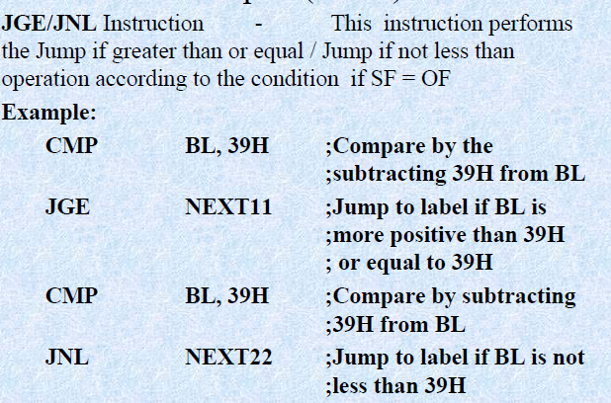
(4). Branching Instructions

Slide 110
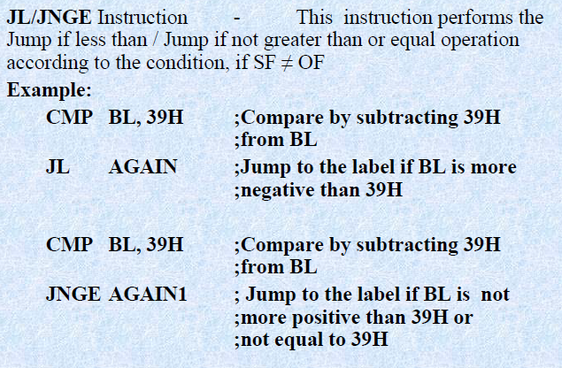
(4). Branching Instructions

Slide 111
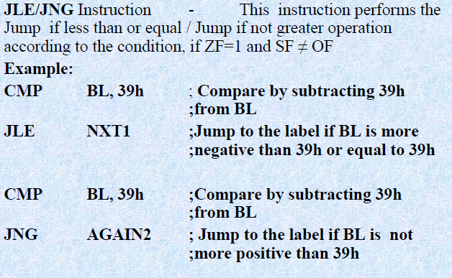
(4). Branching Instructions

Slide 112
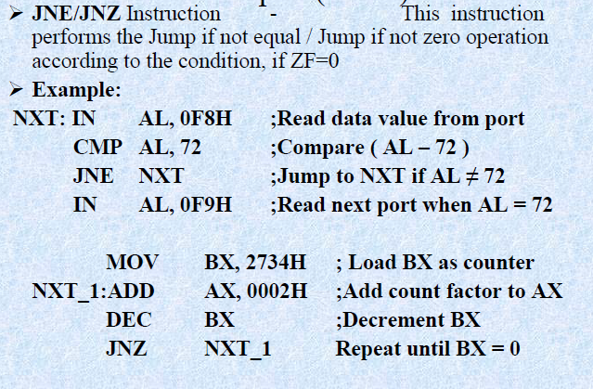
(4). Branching Instructions

Slide 113
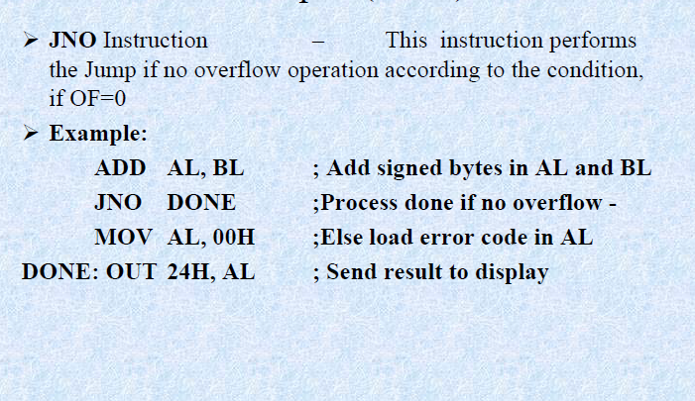
(4). Branching Instructions

Slide 114
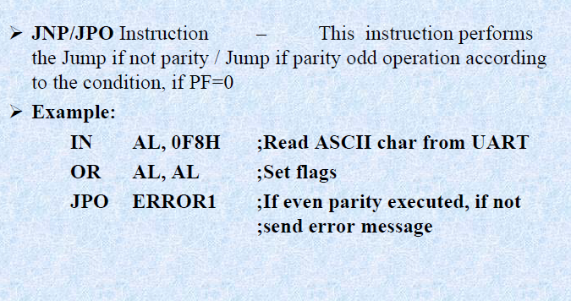
(4). Branching Instructions

Slide 115
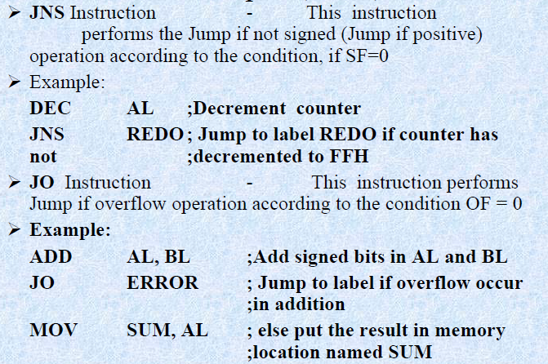
(4). Branching Instructions

Slide 116
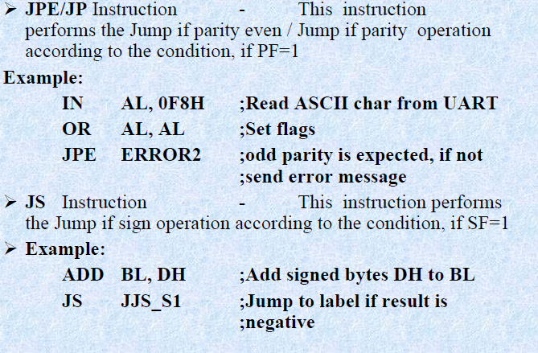
(4). Branching Instructions

Slide 117
(4). Branching Instructions
Interrupt Instructions-These instructions are used to call the interrupt during program execution. Control transferred to the corresponding service routine after pushing all registers and flag to stack.
INT Type - Interrupt program execution
Used to interrupt the program during execution and calling the service specified according to the type number(0- 255)
INTO Instruction - Interrupt on overflow.
Used to interrupt the program during execution if OF=1.
IRET Instruction - Interrupt return.
Used to return from interrupt service to the main program after popping all register values and flag from stack.

Slide 118
(5). LOOP Instructions
(1). LOOP Instruction - This instruction is used to repeat a series of instructions some number of times. Count loaded into CX register ,which auto decrements each time LOOP is executed. If CX=0,goes to the next instruction after the LOOP, otherwise loop repeated.
Example:
MOV BX, OFFSET PRICE ;Point BX at first element in array
MOV CX, 40 ;Load CX with no: of array elements
N1: MOV AL, [BX] ; Get elements from array
ADD AL, 07H ;Add correction factor
DAA ; decimal adjust result
MOV [BX], AL ; Put result back in array
LOOP N1 ; Repeat until all elements adjusted.

Slide 119
LOOPZ/LOOPE and LOOPNZ/LOOPNE Instructions
In these two additional instructions, the state of the ZERO Flag may also cause loop termination in addition to the content of the CX register.
Some action inside the loop should affect the zero flag (e.g. a CMP instruction) before these instructions are executed.
LOOPZ/LOOPE: Loop while (ZF = 1) && (CX<> 0)
LOOPNZ/LOOPNE: Loop while (ZF = 0) && (CX <> 0)
LOOPZ is equivalent to LOOPE
LOOPNZ is equivalent to LOOPNE

Slide 120
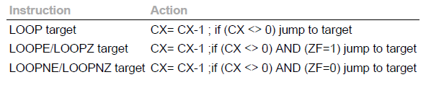
The format of the loop instructions along with the action taken is given in the following table:

Slide 121
(5). LOOP Instructions
(2) LOOPE / LOOPZ Instruction – Loop while CX not =0 and ZF=1
This instruction is used to repeat a group of instruction some number of times(until CX=0) or until ZF = 0.
Example:
MOV BX, OFFSET ARRAY ;point BX at start of the ;array
DEC BX
MOV CX, 100 ;put number of array elements in CX
N1:INC BX ;point to next element in array
CMP [BX], 0FFH ;Compare array elements FFH
LOOPE N1

Slide 122
(5). LOOP Instructions
(3) LOOPNE/LOOPNZ –Loop while CX is not 0 and ZF=0
- This instruction is used to repeat a group of instruction some number of times(until CX = 0 )or until ZF = 1
Example:
MOV BX, OFFSET ARRAY1 ;point BX at start of the array
DEC BX
MOV CX, 100 ;put number of array elements in CX
NEXT:INC BX ;point to next elements in array
CMP [BX], 0DH ;Compare array element with 0DH
LOOPNE NEXT

Slide 123
(5). LOOP Instructions
REP/REPE/REPZ/REPNE/REPNZ - (Prefix) Repeat String instruction until specified conditions exist.
REP- prefix written before a string instruction.
It will cause the CX register to be decremented and
the string instruction to be repeated until CX=0.
REPE/REPZ – Repeat if Equal /Repeat if Zero.
Often used with the compare string or scan string instruction .
REPE CMPSB
REPNE/REPNZ-Repeat if Not Equal/Repeat if Not Zero.
Often used with the scan string instruction.
REPNE SCASW

Slide 124
(6). Machine Control Instructions
(1). HLT
HALT Instruction - The HLT instruction will cause the 8086 to stop fetching and executing instructions.
The 8086 will enter a halt state.
The only way to get the processor out of the halt state are with an interrupt signal on the INTR pin or an interrupt signal on NMI pin or a reset signal on the RESET input .

Slide 125
(6). Machine Control Instructions
(2). NOP- No Operation
This instruction simply uses up the three clock cycles and increments the instruction pointer to point to the next instruction.
NOP does not change the status of any flag.
The NOP instruction is used to increase the delay of a delay loop.

Slide 126
(6). Machine Control Instructions
(3). WAIT- Wait for the test signal or interrupt signal.
When this WAIT instruction executes, the 8086 enters an idle condition. This will stay in this state until a signal is asserted on TEST input pin or a valid interrupt signal is received on the INTR or NMI pin.
This instruction is used to synchronize the 8086 with external hardware such as 8087 math coprocessor.
WAIT affects no flags.

Slide 127
(6). Machine Control Instructions
(4). LOCK – Assert bus lock signal
In a multiprocessor system, each microprocessor only takes control of the system bus when it needs to access some system resource.
The LOCK prefix allows a microprocessor to make sure that another processor does not take control of the system bus while it is in the middle of a critical instruction which uses system bus.
The 8086 will assert its bus lock signal output (connected to an external bus controller device) which then prevents any other processor from taking over the system bus.
No flags affected.
LOCK XCHG SEMAPHORE,AL ; prevents another processor
;from taking control of the system bus ; between the two bus accesses of XCHG.

Slide 128
(6). Machine Control Instructions
(5). ESC
Escape instruction is used to pass instruction to a coprocessor such as the 8087 math coprocessor which shares the address and data bus with an 8086.
Instruction for the coprocessor are represented by a 6 bit code embedded in the escape instruction(ESC instruction followed by a number) or they can be written using specific 8087 mnemonics.
As the 8086 fetches instruction byte, the coprocessor also catches these bytes from data bus and puts them in its queue.
The coprocessor treats all of the 8086 instruction as an NOP.
When 8086 fetches an ESC instruction , the coprocessor decodes the instruction and carries out the action specified by the 6 bit code.
In most of the case 8086 treats ESC instruction as an NOP.

Slide 129
(7). Flag Manipulation Instructions
(1). CMC
If the carry flag CF is zero before this instruction, it will be set to a one after the instruction.
If the carry flag is one before this instruction, it will be reset to a zero after the instruction executes.
CMC has no effect on other flags.
Example:
CMC ;Invert the carry flag.

Slide 130
(7). Flag Manipulation Instructions
(2). CLC
CLC clear the carry flag ( CF ) to 0
This instruction has no affect on the processor, registers, or other flags.
It is often used to clear the CF before returning from a procedure to indicate a successful termination.
It is also use to clear the CF during rotate operation involving the CF such as ADC, RCL, RCR. .

Slide 131
(7). Flag Manipulation Instructions
(3). CLI
This instruction resets the interrupt flag to zero.
No other flags are affected.
If the interrupt flag is reset , the 8086 will not respond to an interrupt signal on its INTR input.
This CLI instruction has no effect on the nonmaskable interrupt input, NMI.

Slide 132
(7). Flag Manipulation Instructions
(4). CLD
This instruction resets the direction flag to zero.
This instruction has no effect on the registers or other flags.
When the direction flag is cleared / reset, SI and DI will automatically be incremented when one of the string instruction such as MOVS, CMPS, SCAS,MOVSB and STOSB executes.
Example :
CLD ;Clear direction flag so that string ;pointers auto increment

Slide 133
(7). Flag Manipulation Instructions
(5) STD
This instruction sets the direction flag to one.
This instruction has no effect on the registers or other flags.
When the direction flag is set, SI and DI will automatically be decremented when one of the string instruction such as MOVS, CMPS, SCAS,MOVSB and STOSB executes.
Example :
STD ;Set direction flag so that string ;pointers auto decrement

Slide 134
(7). Flag Manipulation Instructions
(6). STI –Set Interrupt Flag to one.
Enables the INTR interrupt of the 8086 after the next instruction after STI.
An interrupt signal on this input will then cause the 8086 to interrupt program execution, and an interrupt service routine will be executed after pushing return address and flags to the stack.
STI does not affect any flags.

Slide 135
(7). Flag Manipulation Instructions
(7). STC –Set Carry Flag to 1.

Slide 136
(8). Shift and Rotate Instructions
Shift Instructions
(1) SHL/SAL – SHL/SAL destination, count
Shift operand bits left, put zero in LSBs, MSB shifted into CF
SHR – SHR destination, count
Shift operand bits right, put zero in MSBs, LSB shifted into CF.
(3) SAR – SAR destination, count
Shift operand bits right, new MSB=old MSB, LSB shifted into CF.
Shift instructions position or move numbers to the left or right within a register or memory location.
They also perform simple arithmetic such as multiplication by powers of 2^{n}(left shift) and division by powers of 2^{n}(right shift).
The 8086 supports four different shift instructions: Two are logical shifts and two are arithmetic shifts.

Slide 137
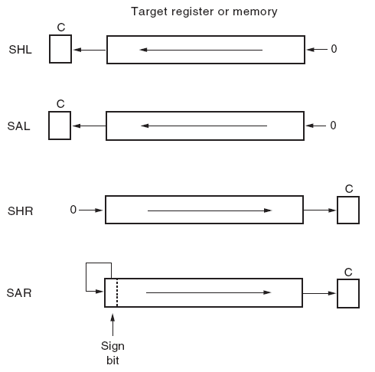
(8). Shift and Rotate Instructions
Shift Left
Shift Arithmetic Left
Shift Right
Shift Arithmetic Right

Slide 138
(8). Shift and Rotate Instructions
The logical shifts(SHL,SHR) move a 0 into the rightmost bit position for a logical left shift and a 0 into the leftmost bit position for a logical right shift.
There are also two arithmetic shifts(SAL,SAR).
The arithmetic shift left(SAR) and logical left shift(SHL) are identical.
The arithmetic right shift(SAR) and logical right shift(SHR) are different because the arithmetic right shift copies the sign-bit through the number, whereas the logical right shift copies a 0 through the number.

Slide 139
(8). Shift and Rotate Instructions
The general format of the shift instructions is
XXX destination, count
Where:
XXX is the shift mnemonic (i.e., SHL, SHR, SAL, SAR),
destination is a general-purpose register or memory reference, and
count is either 1 or in CL register( for shift of N bits).
Examples:
SHL AX, 1
MOV CL,04H
SHL AX, CL

Slide 140
(8). Shift and Rotate Instructions
Rotate Instructions
Rotate instructions position binary data by rotating the information in a register or memory location, either from one end to another or through the carry flag.
Numbers rotate through a register or memory location, through the C flag (carry), or through a register or memory location only.
With either type of rotate instruction, the programmer can select either a left or a right rotate.

Slide 141
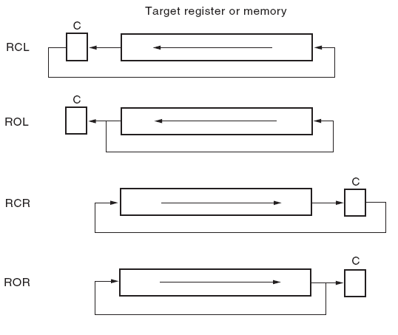
(8). Shift and Rotate Instructions
Rotate Carry Left
Rotate Left
Rotate Carry Right
Rotate Right

Slide 142
(8). Shift and Rotate Instructions
The general format of the shift instructions is
XXX destination, count
Where:
XXX is the rotate mnemonic (i.e., RCL, RCR, ROL, ROR),
destination is a general-purpose register or memory reference, and
count is either 1 or in CL register( for rotate of N bits)
Examples:
ROL AX, 1
MOV CL,05
ROL AX, CL

Slide 143
(8). Shift and Rotate Instructions
Rotate instructions
ROL: rotate left
ROR: rotate right
RCL: rotate left with carry
RCR: rotate right with carry
Effect on flags (shift & rotate instructions):
SF, PF, ZF change based on result
AF undefined
CF= last bit shifted
OF=1 if sign bit changes on single-bit shifts.
ROL/ROR: can be used to swap the nibbles in byte or to swap the bytes in a word. It can also be used to rotate a bit into CF where it can be checked and acted upon by the conditional jump instructions(JC or JNC).

Slide 144
(9). String Manipulation Instructions
Five categories
MOVS/ MOVSB/ MOVSW
CMPS/ CMPSB/ CMPSW
SCAS/ SCASB/ SCASW
LODS/ LODSB/ LODSW
STOS/ STOSB/ STOSW
Source is always in DS:[SI]
Destination is always in ES:[DI]
If DF=0, SI and DI are incremented
If DF=1, SI and DI are decremented
To clear direction flag: CLD
To set direction flag: STD

Slide 145
(9). String Manipulation Instructions
(1). MOVS/ MOVSB/ MOVSW
An element of the string specified by the source index (SI) register with respect to the current data segment (DS) register is moved to the location specified by the destination index (DI) register with respect to the current extra segment (ES) register.
The move can be performed on a byte (MOVSB) or a word (MOVSW) of data.
After the move is complete, the contents of both SI & DI are automatically incremented or decremented by 1 for a byte move and by 2 for a word move.
Address pointers SI and DI increment or decrement depends on how the direction flag DF is set.

Slide 146
(9). String Manipulation Instructions
(2). CMPS/ CMPSB/ CMPSW
Also known as Compare String Byte or String Word.
The CMPS instruction can be used to compare two strings of byte or words.
The length of the string must be stored in the register CX. If both the byte or word strings are equal, zero Flag is set.
The REP instruction Prefix is used to repeat the operation till CX (counter) becomes zero or the condition specified by the REP Prefix is False.
There are following sub types,
(i). CMPSB:- Compare String Byte.
(ii). CMPSW:- Compare String Word.

Slide 147
(9). String Manipulation Instructions
(3). SCAS/ SCASB/ SCASW-Scan String Byte or String Word
This instruction scans a string of bytes or words for an operand byte or word specified in the register AL or AX.
The String is pointed to by ES:DI register pair.
The length of the string s stored in CX.
The DF controls the mode for scanning of the string.
Whenever a match to the specified operand, is found in the string, execution stops and the zero Flag is set. If no match is found, the zero flag is reset.

Slide 148
(9). String Manipulation Instructions
(4). LODS/ LODSB/ LODSW
This instruction copies a byte from a string location pointed to by SI to AL or a word from a string location pointed to by SI to AX.
If DF is cleared to 0,SI will automatically incremented to point to the next element of string.
Example:
CLD ;Clear direction flag so SI is auto incremented
MOV SI, OFFSET SOURCE_STRING
;point SI at start of the string
LODS SOURCE_STRING ;Copy byte or word from
;string to AL or AX

Slide 149
(9). String Manipulation Instructions
(5). STOS/ STOSB/ STOSW-Store String Byte or String Word
The STOS instruction Stores the AL / AX register contents to a location in the string pointer by ES : DI register pair.
The DI is modified accordingly, No Flags are affected by this instruction.
The direction flag controls the String instruction execution.
The Source Index SI and Destination Index DI are modified after each iteration automatically.
If DF=1, then the execution follows auto decrement mode, SI and DI are decremented automatically after each iteration.
If DF=0, then the execution follows auto increment mode. In this mode, SI and DI are incremented automatically after each iteration.

Slide 150
Assembler directives

Slide 151
Assembler Directives
Assembler Directives are directions to the assembler.
Assembler directives are the commands to the assembler that direct the assembly process.
They indicate how an operand is treated by the assembler and how assembler handles the program.
They also direct the assembler how program and data should be arranged in the memory.

Slide 152
Data Definition Directives (cont.)
The amount of memory to be allocated is determined by the directive itself.
Use the appropriate DEFINE directive (byte, word, etc.)
Define byte
DB
DW
Define word
Define double word
DD
Define quad
word
DQ
DT
Define ten bytes

Slide 153
Define Byte
The DB directive is used to declare a byte type variable, or a set aside one or more storage locations of type byte in memory.
NAME_HERE DB ‘THOMAS’; declares array of 6 bytes and initialize with ASCII codes fro letters in THOMAS.
PRICES DB 49H,98H,29H; declare array of 3 bytes PRICES and 3 bytes as shown.

Slide 154
Define Byte (cont)
A variable’s value may be left undefined. This can be done by placing a ‘?’ for each byte to be allocated (as in a list).
count db ?
A string may be assigned to a variable, each of whose elements will be allocated a byte.
c_string db ‘This is a long string$’
The length of a string can be automatically determined by the assembler by the ‘$’ symbol.

Slide 155
DW (DEFINE WORD)
The DW directive is used to tell the assembler to define a variable of type word or to reserve storage locations of type word in memory.
MULTIPLIER DW 437AH; declares a variable MULTIPLIER of type word initialized with a value 437AH when program loaded to memory.

Slide 156
Define Doubleword – DD
Same as DB and DW, except the memory allocated is now 4 bytes (2 words, 32 bits).
[name] DD initialvalue [,initialvalue]
The name is the name of the variable. Notice that it is optional.
initialvalue can be one or more 32-bit numeric values, either in dec., hex or bin. form, string const., a const. Expression, or ?

Slide 157
DUP
Allows a sequence of storage locations to be defined or reserved
Only used as an operand of a define directive
STORAGE DB 40 DUP (?); reserve 40 bytes in memory ,but uninitialized
STORAGE DW 100 DUP (0);reserve 100 words in memory and all initialized to 0.

Slide 158
DQ and DT
DQ (DEFINE QUADWORD)
The DQ directive is used to tell the assembler to declare a variable 4 words in length or to reserve 4 words of storage in memory.
DT (DEFINE TEN BYTES)
The DT directive is used to tell the assembler to declare a variable, which is 10 bytes in length or to reserve 10 bytes of storage in memory.

Slide 159
ASSUME
The ASSUME directive is used tell the assembler the name of the logical segment it should use for a specified segment.
Example
ASSUME CS:CODE_HERE; tells the assembler that the instructions for program are in logical segment CODE_HERE.
ASSUME DS:DATA_HERE ;tells the assembler that for any program instruction which refers to the data segment ,it should use the logical segment
Called DATA_HERE .

Slide 160
END (END Program)
The END directive is put after the last statement of a program to tell the assembler that this is the end of the program module.
The assembler will ignore any statements after the END directive.

Slide 161
Segment & ENDS(End Segment)
SEGMENT : Used to indicate the beginning of a code/ data/ stack segment
ENDS : Used to indicate the end of a code/ data/ stack segment
General form:
Segname SEGMENT … … … … … … Segname ENDS | Program code or Data Defining Statements
User defined name of the segment

Slide 162
PROC,ENDP,FAR & NEAR
PROC- Indicates the beginning of a procedure.
The PROC directive follows a name you give the procedure. After the PROC directive, the term near or the term far is used to specify the type of the procedure.
ENDP- End of procedure. The PROC directive is used with the ENDP directive to “bracket” a procedure.
FAR- Inter segment call - the procedure resides in the same code segment. (Local)
NEAR - Intra segment call - resides at any location in the memory
General form
procname PROC[NEAR/ FAR] … … … RET procname ENDP | Program statements of the procedure Last statement of the procedure
User defined name of the procedure

Slide 163
Examples
ADD64 PROC NEAR … … … RET ADD64 ENDP | The subroutine/ procedure named ADD64 is declared as NEAR and so the assembler will code the CALL and RET instructions involved in this procedure as near call and return
CONVERT PROC FAR … … … RET CONVERT ENDP | The subroutine/ procedure named CONVERT is declared as FAR and so the assembler will code the CALL and RET instructions involved in this procedure as far call and return

Slide 164
EQU Directive
EQU is used to give a name to some value or symbol.
Each time the assembler finds the given name in the program, it replaces the name with the value or symbol you equated with that name.
name EQU expression
expression can be string or numeric
Use < and > to specify a string EQU
these symbols can be redefined with a different value.
Num1 EQU 50H
Num2 EQU 66H
message EQU <This is a message>

Slide 165
EVEN -Align on even memory address
The EVEN directive tells the assembler to increment the location counter to the next even address if it is not already at an even address.
The 8086 can read a word from memory in one bus cycle if word is at even address and two bus cycles, if word is at Odd address.
A NOP instruction is inserted in the location incremented over.
Example:
Data Segment
Average DB 9 DUP (?) ; array of 9 bytes ,so location ;counter at 0009 now
EVEN ; Increment location counter to 000AH
Record DW 100 DUP (0);array of 100 words starting ;on an even address for quicker read.
Data ends

Slide 166
EXTRN
The EXTRN directive is used to tell the assembler that the name or labels following the directive are in some other assembly module.
Example: For calling a procedure which is in a program module assembled at a different time, you must tell the assembler that the procedure is external.
The assembler will then put the information in the object code file so that the linker can connect the two modules together.
1. For referred Variables ,type should be specified.
EXTRN DIVISOR: BYTE
2 . For a referenced Label - + near/far
EXTRN SMART: FAR
Names/ Labels referred to as external in one module must be declared public with the PUBLIC directive.
EXTRN Statements should usually be bracketed with SEGMENT - ENDS directive.
PROCEDURE SEGMENT
EXTRN SMART:FAR
PROCEDURE ENDS

Slide 167
PUBLIC / GLOBAL
Large program are usually written as several separate modules.
Each module is individually assembled, tested, and debugged.
When all the modules are working correctly, their object code files are linked together to form the complete program.
In order for the modules to link together correctly, any variable name or label referred to in other modules must be declared PUBLIC in the module in which it is defined.
The PUBLIC directive is used to tell the assembler that a specified name or label will be accessed from other modules.
Example:
The statement
PUBLIC DIVISOR, DIVIDEND
which makes the two variables DIVISOR and DIVIDEND available to other assembly modules.

Slide 168
GROUP-Group Related Segments.
The GROUP directive is used to tell the assembler to group the logical segments named after the directive into one logical group segment.
Example:
SMALL_SYS GROUP CODE,DATA,STACK.
ASSUME CS: SMALL_SYS, DS: SMALL_SYS, SS: SMALL_SYS.

Slide 169
INCLUDE (INCLUDE SOURCE CODE FROM FILE)
This directive is used to tell the assembler to insert a block of source code from the named file into the current source module.

Slide 170
LABEL
As an assembler assembles a section of a data declarations or instruction statements, it uses a location counter to be keep track of how many bytes it is from the start of a segment at any time.
The LABEL directive is used to give a name to the current value in the location counter.
The LABEL directive must be followed by a term that specifies the type you want to associate with that name like type near or type far, type byte, type word, or type double word etc.
LABEL directive for a far jump address.
ENTRY_POINT LABEL FAR ; Can jump to here from ;another segment
LABEL directive for a data reference.
DATA SEGMENT
DATAS DB 50H DUP(?)
DATA-LAST LABEL BYTE FAR
DATA ENDS

Slide 171
LENGTH-Byte Length of a Label
Not available in MASM.
Used to refer to the length of a data array or a string.
Example:
MOV CX, LENGTH ARRAY
Here assembler substitutes the length of the array ARRAY in bytes, in the instruction.

Slide 172
LOCAL
The labels, variables ,constants or procedures declared LOCAL in a module are to be used only by that particular module.
Different modules can use the same variable names if declared as LOCAL.
Example:
LOCAL a,b,DATA,ARRAY1,ROUTINE

Slide 173
NAME-Logical Name of a Module
The NAME directive is used to give a specific name to each assembly module when programs consisting of several modules are written.

Slide 174
OFFSET
It is used to determine the offset/ displacement of a named data item from the start of the segment which contains it.
Used to ,load the offset of a variable into a register so that the variable can be accessed with one of the indexed addressing modes.
Example:
MOV BX, OFFSET Prices ; load BX with displacement
;of PRICES from its segment base.
ADD AX, [BX]

Slide 175
ORG (ORIGIN)
ORG Changes the starting offset address of the data in the data segment.
The location counter is automatically set to 0000 when assembler starts reading a segment.
The ORG directive allows you to set the location counter to a desired value at any point in the program.
Example: ORG 2000H ; tells the assembler to set the location counter to 2000H.
A “$” it often used to symbolically represent the current value of the location counter. The $ is often used in ORG statements to tell the assembler to make some change in the location counter relative to its current value.
The statement ORG $ + 100 tells the assembler increment the value of the location counter by 100 from its current value.

Slide 176
PTR Operator
The PTR operator is used to assign a specific type to a variable or to a label.
Example:
1. INC [BX]
It will not know whether to increment byte/word.
INC BYTE PTR [BX]
2. Array of words:
WORDS DW 437AH, OB927H, 7C41 H ; normally array of ; words can be accessed.
For accessing a byte in the array
MOV AL, BYTE PTR WORDS.
3. for Jump Instructions:
JMP [BX] ; near or far jump?
JMP WORDPTR [BX];for a near jump
JMP DWORDPTR [BX];for a far jump

Slide 177
SHORT
The SHORT operator is used to tell the assembler that only a 1 byte displacement is needed to code a jump instruction in the program.
The destination must in the range of –128 bytes to +127 bytes from the address of the instruction after the jump.
This method of specifying the jump address saves the memory.
Otherwise, the assembler may reserve 2 bytes for the displacement.
Example:
JMP SHORT NEARBY_LABEL

Slide 178
SEG: Segment of a label
SEG operator is used to decide the segment address of the label, variable, or procedure and substitutes the segment base address in place of “SEG” label.
Example:
MOV AX,SEG ARRAY
MOV DS,AX
This statement moves the segment address of ARRAY in which it is appearing, to register AX and then to DS.

Slide 179
TYPE
The TYPE operator tells the assembler to determine the type of a specified variable and replaces the ‘TYPE’ label by the decided data type.
The assembler actually determines the number of bytes in the type of the variable.
For a byte-type variable, the assembler will give a value of 1, for a word-type variable, the assembler will give a value of 2, and for a double word-type variable, it will give a value of 4.
Example:
MOV AX,TYPE STRING1; moves the value 0002H in AX if STRING1 is a word array.

Slide 180
MACRO - ENDM
MACRO Indicate the beginning of a macro
ENDM End of a macro
General form:
macroname MACRO[Arg1, Arg2 ...] … … … macroname ENDM | Program statements in the macro
User defined name of the macro
When you want to use a macro, you can just type its name.
For example: MyMacro ; If MyMacro is the name of the macro.
To pass parameters to macro, you can just type them after the
macro name.
For example: MyMacro 1, 2, 3;

